Slide 1
SmartLeaf Indoor Greenhouse System
Group 12
Alex Lam – CpE/EE
Dany Mazboudi – EE
Jonathan Gilbert – CpE
Megan Morris - EE

Slide 2
Administrative Introduction
Alex
Dany
Jon
Megan
GUI
Software Control
Microcontroller Communication
PCB Design
Sensors
Schematics
Software
IoT communication
PCB Design
Power Supply
Control Circuits & Programming
Greenhouse Design

Slide 3
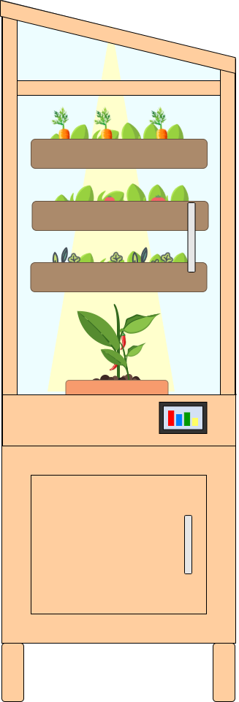
Project Description
Project Goals
Unit will provide a nurturing & sustainable environment for plant growth
Environmental controls will be triggered by sensor data
Users can monitor greenhouse data remotely through web application
Project objective
Provide a fool-proof & fun gardening experience that can produce fresh fruit and vegetables, regardless of environment

Slide 4
Project Motivation
Address the rise of “food deserts” - defined by the USDA as regions of the country without ready access to healthy and affordable food
23.5mil Americans live in food deserts
2.1mil households do not own a vehicle and live more than 1 mile from the nearest grocery store
Low-income zip codes have 30% more convenience stores with limited selection of produce, as compared to middle-class zip codes
Residents of low-income zip codes pay up to 37% more at these small neighborhood stores for produce as compared to their middle-class peers
Direct access to healthy food can positively impact food deserts

Slide 5
Project Specifications & Requirements
Requirements
System must be equipped to provide water, humidity, air circulation, and ample lighting for photosynthesis
Set-up and maintenance is achievable in a home or office environment
Parameter | Specification
Height | < 6ft
Weight | < 50lbs
Max. Power Consumption | 7.1W
Bluetooth Range | 10m
Humidity Range | 50-60%
LED Growlight Sequence Time | 6-8hrs
Hygrometer Polling Rate | 1 measurement per minute
Soil Moisture Sensor Polling Rate | 1 measurement every 6 hrs

Slide 6
Environmental Requirements
Plant Need | Provision | Engineering System
Sunlight | Radiant energy light source with either a full spectrum of light or red and blue wavelengths | LED strip lights of blue and red wavelengths on a timed schedule, 6-8 hours per day
Water | A watering system that fully waters plants only when the soil is dry and has a means of collecting and removing excess water from the soil to prevent root rot | Pump and tubing that delivers water to plant beds when moisture sensor indicates dry soil; runoff system that collects water prior to drainage
Balanced pH | Monitoring of soil pH to indicate nutrient absorption | pH sensor that communicates levels to be displayed to the user
Humidity | Relative humidity monitoring and maintenance of at least 50% | Small diffuser that activates upon low hygrometer measurements
Airflow | A ventilation system for providing carbon dioxide and preventing disease | Fans that operate on a regular basis and upon high hygrometer measurements

Slide 7
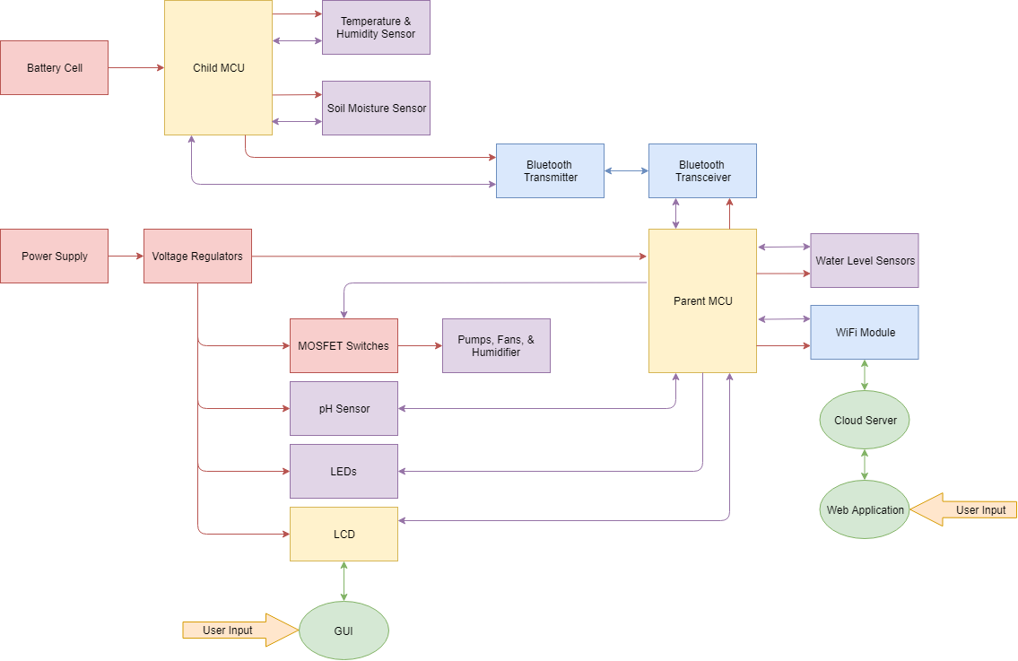
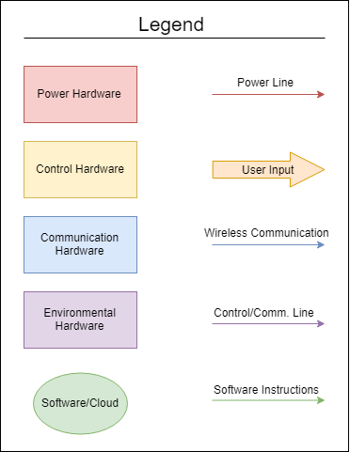
Project Block Diagram

Slide 8
Child UML Diagrams

Slide 9
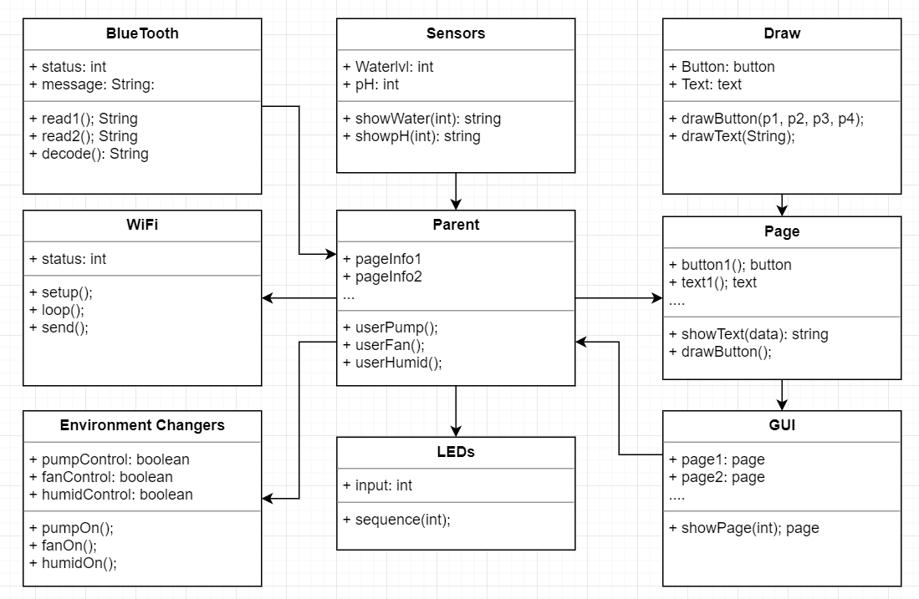
Parent UML Diagrams

Slide 10
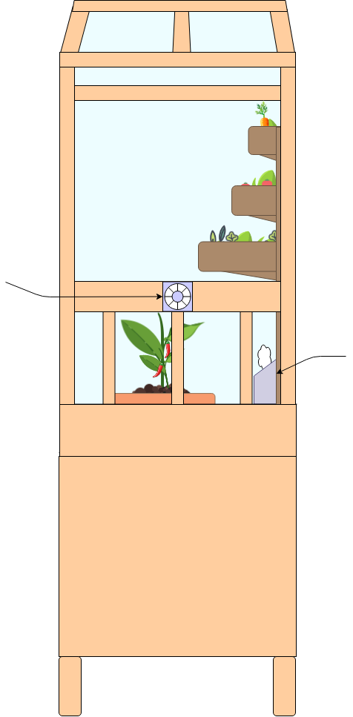
Project Design
12V Fan
5V Humidifier Disk

Slide 11
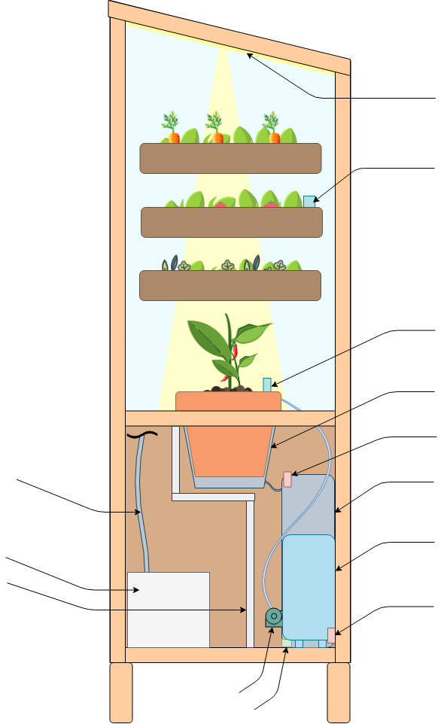
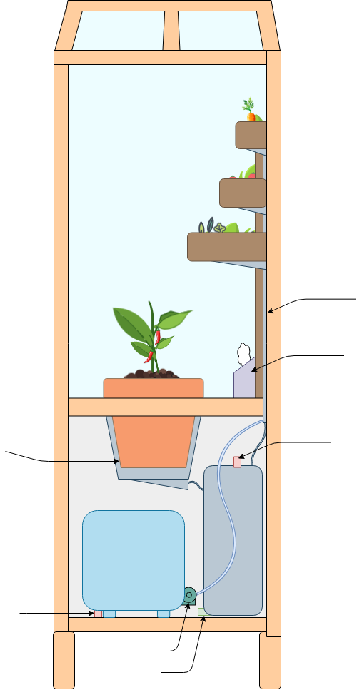
Project Design
5V LEDs
Soil Moisture Sensor & child MCU
Soil Moisture Sensor, LCD, & child MCU
Drainage Line
5V Humidifier Disk
Drainage Collect
Water Level Sensor
Water Level Sensor
Power to LEDs & Humidifier
Drainage Tank
Drainage Collect
PCB & Power Components
Clean Water Tank
Water Barrier
Water Level Sensor
Water Level Sensor
Pump
Pump
pH Sensor
pH Sensor

Slide 12
Power Supply
Power Supply | Voltage & Current Rating | Warranty | Dimensions | Cost | Connection Type
Idealy IP67 Waterproof Power Supply | 12V/10A | 2 year | 6.61”x 2.67”x 0.78” | $31.99 | NEMA-15P
Yaetek IP67 Waterproof Power Supply | 12V/10A | N/A | 1.6” x 2.8” x 7.5” | $16.99 | No plug
YGS-Tech IP67 Waterproof Power Supply | 12V/10A | 1 year | 6” x 2.71” x 0.6” | $39.99 | NEMA-15P

Slide 13
Power Supply
Power Supply | Voltage & Current Rating | Warranty | Dimensions | Cost | Connection Type
Idealy IP67 Waterproof Power Supply | 12V/10A | 2 year | 6.61”x 2.67”x 0.78” | $31.99 | NEMA-15P
Yaetek IP67 Waterproof Power Supply | 12V/10A | N/A | 1.6” x 2.8” x 7.5” | $16.99 | No plug
YGS-Tech IP67 Waterproof Power Supply | 12V/10A | 1 year | 6” x 2.71” x 0.6” | $39.99 | NEMA-15P

Slide 14
Switching Regulators
Load | Required Voltage | Demand Current | Regulator | Manufacturer | Description | Footprint | Efficiency | Total Price (Reg. + Components)
LEDs | 5V | 12A | TPS40305 | Texas Instruments | Switcher: Synchronous Buck Controller | 17mm² | 91.7% | $2.99
Pumps | 12V | 2A | TPS55330 | Texas Instruments | Switcher: X version, 1.6MHz, 22V Internal FET | 17mm² | 95.9% | $2.52
Fans | 12V | 0.44A | LMR62014X | Texas Instruments | Switcher: Wide Input Range Boost DC/DC Converter | 15mm² | 95.6% | $0.82
Humidifier | 5V | 0.5A | TPS560430Y | Texas Instruments | Switcher: 4V to 36V 0.6A Synchronous Step-Down Converter | 15mm² | 88.5% | $1.27
LCD | 5V | 0.15A | TPS62175 | Texas Instruments | Switcher: High Light-Load Efficiency Buck Converter | 12mm² | 90.6% | $0.96
MSP432 | 3.3V | 0.1A | TPS62177 | Texas Instruments | Switcher: Fixed 3.3Vout, High Light-Load Efficiency Buck Converter | 12mm² | 85% | $0.86
pH Sensor | 5V | 0.5A | TPS560430Y | Texas Instruments | Switcher 4V to 36V 0.6A Synchronous Step-Down Converter | 15mm² | 88.5% | $1.27

Slide 15
Switching Regulators

Slide 16
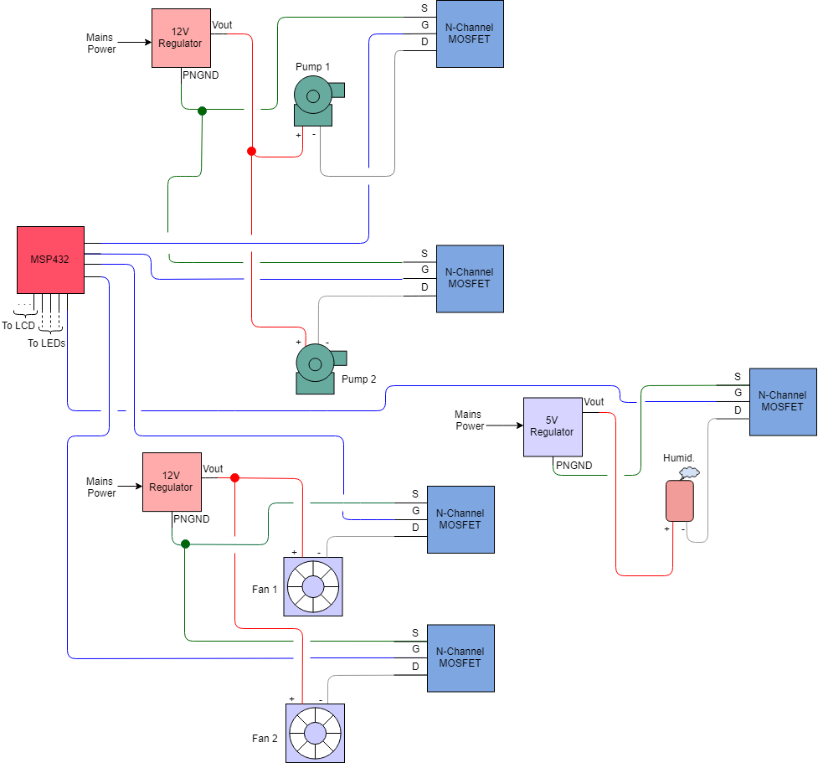
Control Circuits
Switch: N-Channel Enhancement Type Logic Level MOSFET
MCU pulls gate high/low to switch device ON/OFF respectively
Basic ON/OFF Control & Motor speed with PWM

Slide 17
Control Circuits
MOSFET | Manufacturer | Description | V_{GS(th)} | V_{DS} | I_{D} | Footprint | Price
CSD18501Q5A | TI | 40 V N-Channel NexFET™ Power MOSFET | 1.4-2.3V | 40V | 20A | 5mm x 6mm | $1.50
BUK9M20-40H | Nexperia | N-Channel Logic Level Enhancement Mode FET | 1.8-2.2V | 50V | 25A | 6mm x 6mm | $1.67

Slide 18
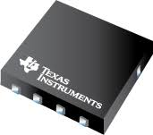
Control Circuits
MOSFET | Manufacturer | Description | V_{GS(th)} | V_{DS} | I_{D} | Footprint | Price
CSD18501Q5A | TI | 40 V N-Channel NexFET™ Power MOSFET | 1.4-2.3V | 40V | 20A | 5mm x 6mm | $1.50
BUK9M20-40H | Nexperia | N-Channel Logic Level Enhancement Mode FET | 1.8-2.2V | 50V | 25A | 6mm x 6mm | $1.67

Slide 19
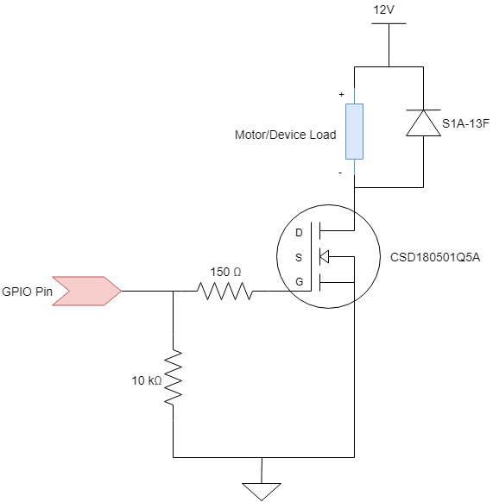
Control Circuits
Fans & pumps are inductive loads that add a spike in voltage when switched (flyback)
Flyback diode added for protection

Slide 20
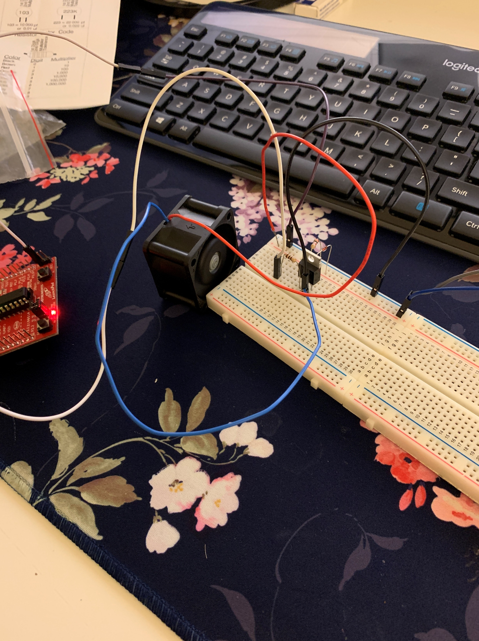
Control Circuits
Motors & pumps are inductive loads that add a spike in voltage when switched (flyback)
Flyback diode added for protection

Slide 21
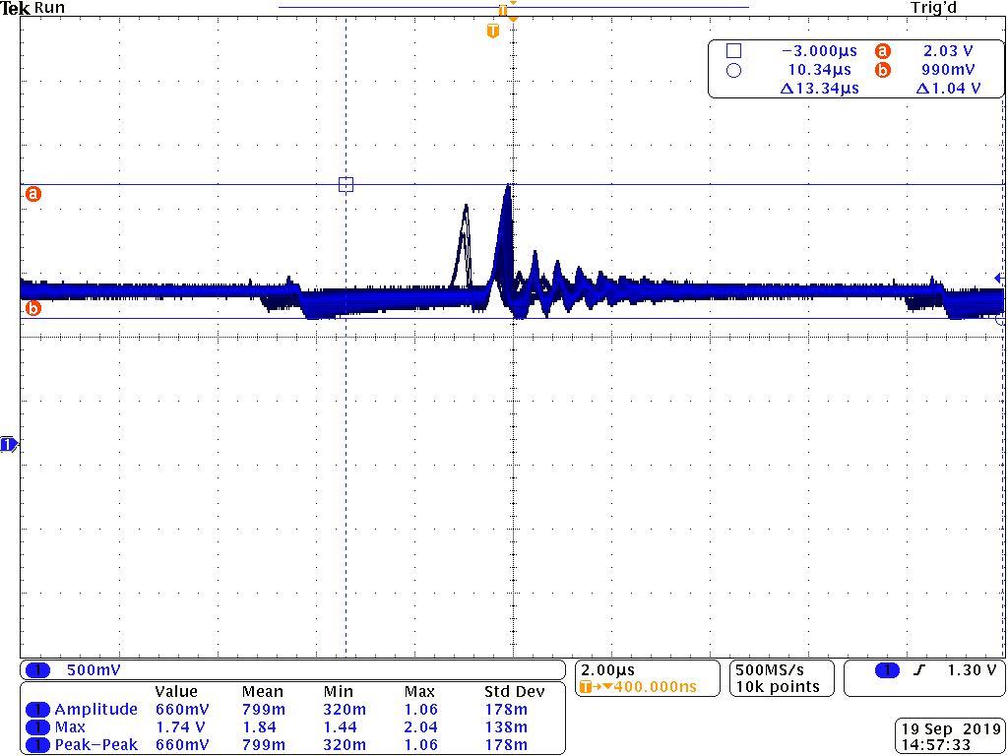
Control Circuits

Slide 22
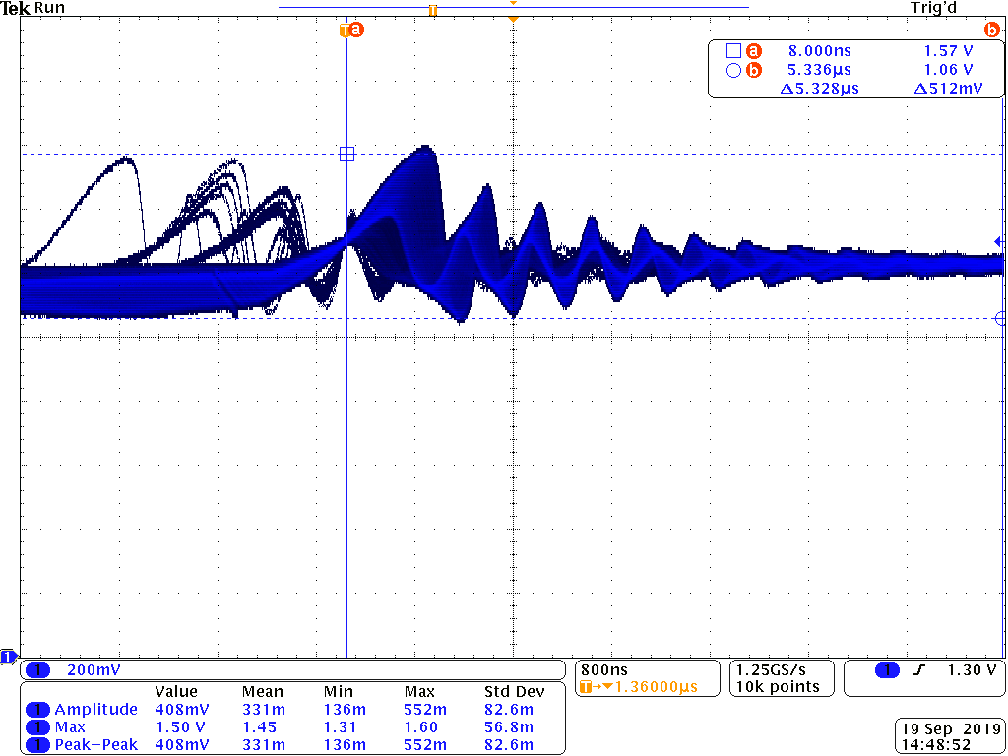
Control Circuits

Slide 23
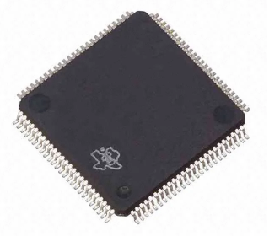
Parent Microcontroller Prototype
Microcontroller Options | Chip Name | Manufacturer | Speed | Core Processor | Core Size | Dev Board Price | Chip Price
Arduino Mega 2560 | ATmega2560 | Arduino | 16MHz | ARV | 8-bit | $38.50 | $12.35
MSP-EXP432P401R Launchpad | MSP432P401R | TI | 48MHz | ARM Cortex M4F | 32-bit | $39.95 | $7.46
Justification
More powerful processor
Easy to access libraries
Complexity and comfortability
Price

Slide 24
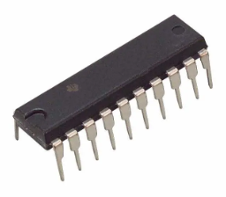
Child Microcontroller Prototype
Microcontroller Options | Chip Name | Manufacturer | Speed | Core Processor | Core Size | Dev Board Price | Chip Price
Arduino Uno Rev3 | ATmega238P | Arduino | 16MHz | ARV | 8-bit | 12.35 | $2.14
MSP-EXP430G2 Launchpad | MSP432P401R | TI | 16MHz | MSP430 | 16-bit | $13.45 | $2.69
Reasons for Choosing this Microcontroller
Easy to access libraries
Ease to communicate to parent controller
Complexity and comfortability

Slide 25
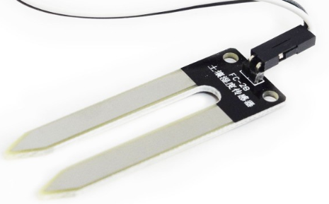
LM393 Soil Moisture Sensor
Soil Moisture Sensor | Manufacturer | Voltage Inputs | Maximum Current | Operating Temperatures | Price
LM393 | Smart Prototyping | 3.3-5V | <20mA | 10-30°C | $2.99
TE215 | XCSource | 5V | <20mA | 10-30°C | $6.59
Justification
Accuracy
Price
Easy to use and test

Slide 26
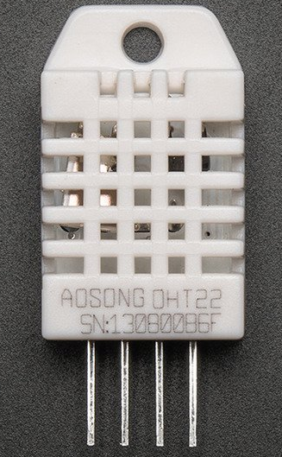
DHT22 Temperature and Humidity Sensor
Justification
Accuracy
Full range of humidity readings (0-100%)
Price
Temp & Humidity Sensor | Manufacturer | Voltage Inputs | Maximum Current | Operating Temperatures | Price
DHT22 | Adafruit | 3-5V | 2.5mA | -40-125°C | $9.95
AM2302 | Adafruit | 3-5V | 2.5mA | -40-125°C | $15.00

Slide 27
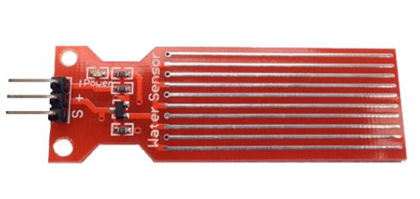
High Sensitivity Water Sensor - RED
Water Level Sensor | Manufacturer | Voltage Inputs | Maximum Current | Operating Temperatures | Price
High Sensitivity Water Sensor | Emartee | 3.3-5V | <20mA | 10-30°C | $4.99
Water Level Liquid Depth Sensor | WINGONEER | 3-5V | <20mA | 10-30°C | $6.99
Justification
Notify the user when the water level is low/high
Accuracy
Price

Slide 28
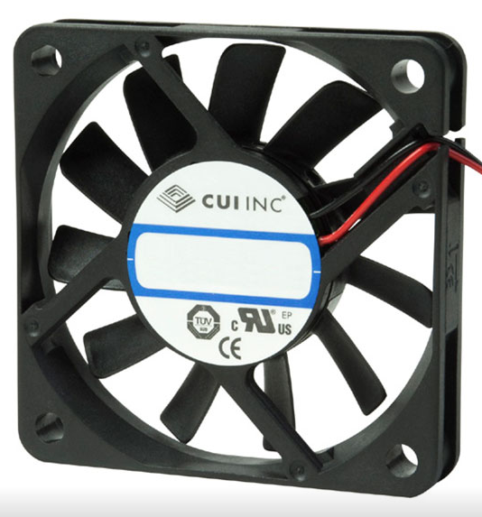
Fan
Justification
Gives us the best airflow for our system
Reasonable Price
Fan Options | Manufacturer | Power Requirements | Noise | Airflow | Cost
RA04010HD1 | RDK | 12V, 90mA | 28 dBA | 6.08 CFM | $13.99
490-CFM-5010-03-22 | CUI | 5V, 280mA | 36 dBA | 16.07 CFM | $7.90
CFM-6015-13-22 | CUI | 12V, 220mA | 39 dBA | 27.50 CFM | $8.74

Slide 29
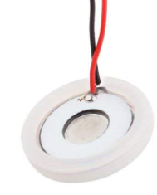
Humidifier
Humidifier Options | Manufacturer | Power Requirements | Price
B00PAK245E | AGPtek | 24V, 1A | $9.99
11434 | IC Station | 5V, 400mA | $5.99
Justification
Small size and low power consumption
Price

Slide 30
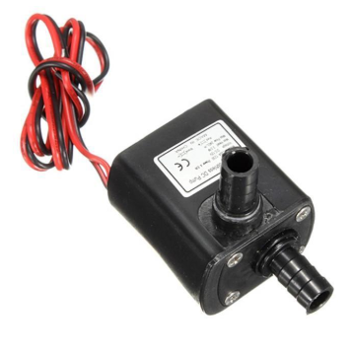
Water Pump
Water Pump Options | Manufacturer | Power Requirements | Price
Submersible Mini Pump | Ledgle | 12V, 300mA | $8.99
Submersible Brushless Water Pump | Daniu | 12V, 400mA | $7.88
Peristaltic Liquid Pump | Adafruit | 5V, 500mA | $24.95
Justification
Lowest demand for current
Reasonable Price

Slide 31
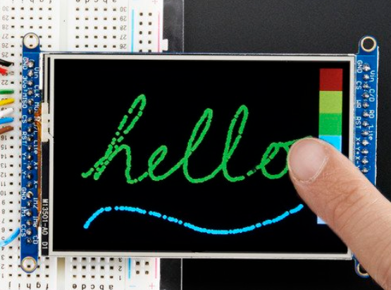
LCD Touchscreens
LCD Options | Manufacturer | Display | Power Requirements | Price
Kentec QVGA Display BoosterPack | Kentec | 3.5 inch 320x240 | 5V | $24.99
HXD8357D | Adafruit | 3.5 inch 320x480 | 5V | $39.95
Reasons for Choosing this Touchscreen
Small size and low power consumption
Library availabilities
Price

Slide 32
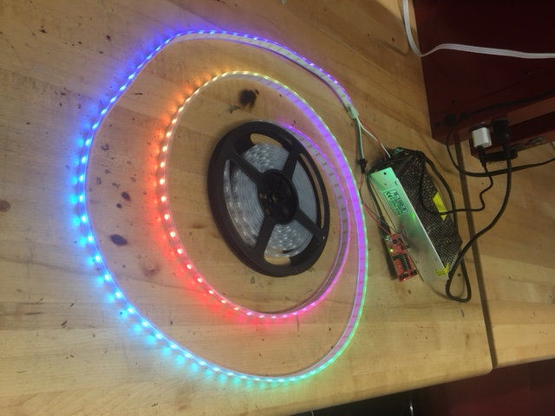
LEDs
LED Options | Manufacturer | Power Requirements | Price
WS2811 | Alitove | 5V, 180mA max per LED set | $26.99
WS2812B | Chinly | 5V, 60mA max per LED | $31.85
Justification
Easy to control each individual LED
Easily assessable examples

Slide 33
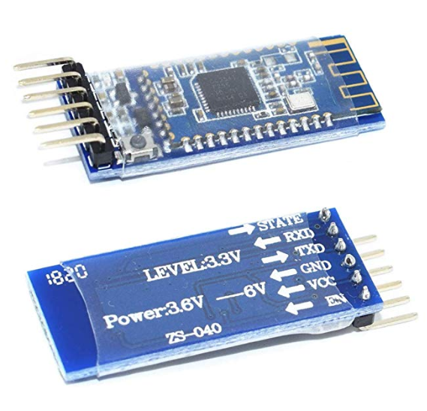
Bluetooth Modules
Module Options | Manufacturer | Chip | Power Requirements | Price
HM-18 | DSD Tech | CC264R2F | 5V | $9.99
HM-10 | HiLetgo | CC2540 | 3.3V-5V | $4.50
Justification
Price
BLE 4.0
UART communication

Slide 34
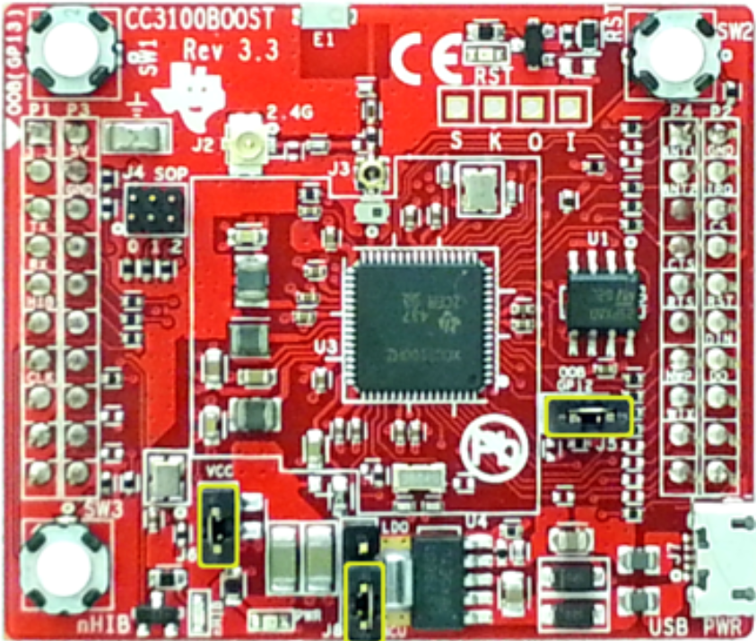
WiFi Modules
Reasons for Choosing this module
Price
Compatibility
Support
Module Options | Manufacturer | Chip | Power Requirements | Price
CC3100BOOST | TI | CC3100 | 3.3V-5V | $19.99
CC3220SF-LAUNCHXL | TI | CC3220SF | 3.3V-5V | $49.99

Slide 35
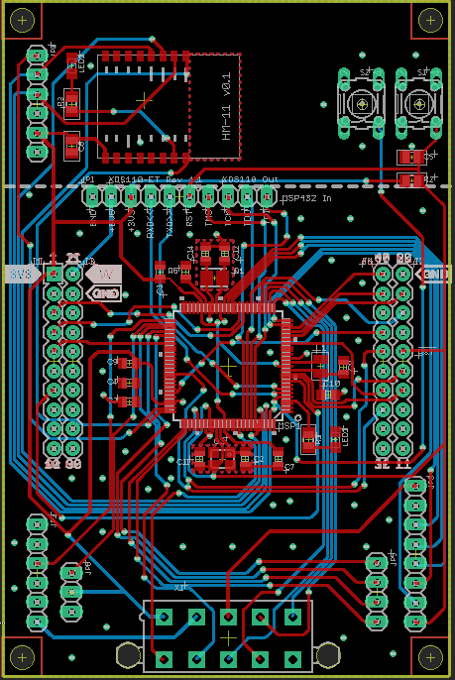
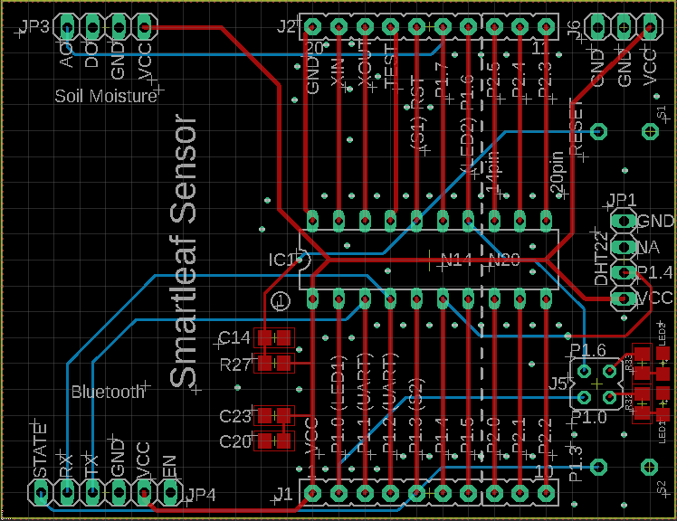
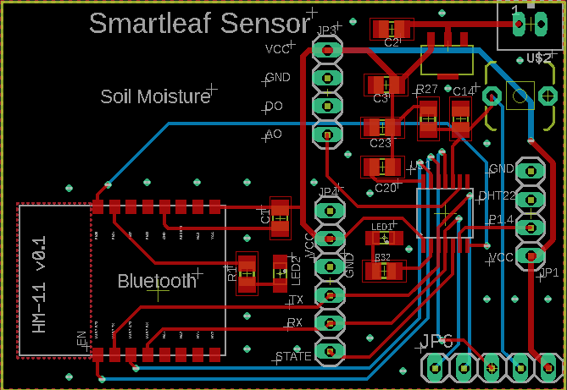
Parent and Child PCB
Parent PCB
Child PCB
Version 1
Version 2

Slide 36
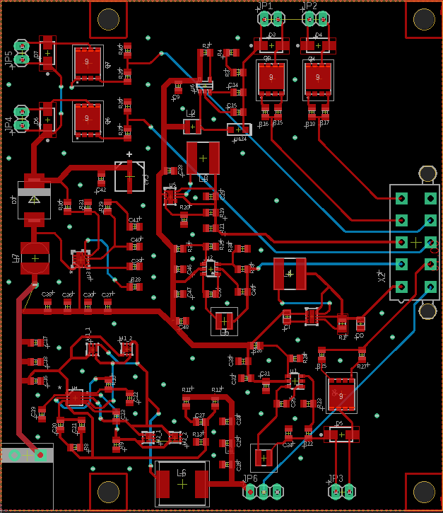
Power PCB
Designed in Eagle
Design files available on TI
Ordered through PCBway
Fast shipping and cheap
$5 PCB with 2 layer <100mm board
Solder Power PCB and Main PCB together

Slide 37
Communication
Sensor modules collect data from the plants and send the readings over Bluetooth to a parent edge device.
Scalable
Wireless
Low power
MSP432 gathers sensor information and communicates through MQTT messages over WiFi
JSON message packets
PubNub
Secure

Slide 38
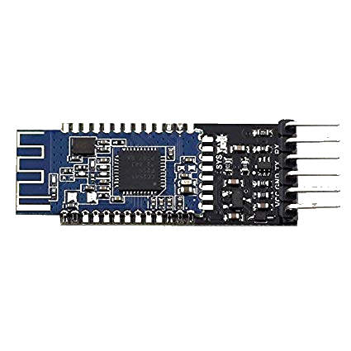
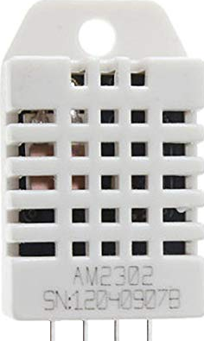
Sensor Module
Hardware
MSP430G2553
HM10 BLE
Soil Moisture
Temperature/Humidity
Lithium Ion Battery
Software
Timer operated
Low power efficient
Low memory footprint

Slide 39
Parent Module
Hardware
MSP432p401r
CC3100BOOST WiFi
HM10 BLE
Humidifier
Fans
Water Pumps
LEDs
Software
TI RTOS
PubNub API
Star-Network
Controls
Sensor activated
Timer regulated
User interaction

Slide 40
PubNub
Broadcasts published messages to subscribed devices using MQTT
Subscribes to web server control
Recieves published sensor data

Slide 41
Web Application
Losant
IoT platform
Buildable Dashboard
Display sensor data about the plants
Graphs that display changes in readings over time
Database included
Control panel
Send commands to edge device
View system state

Slide 42
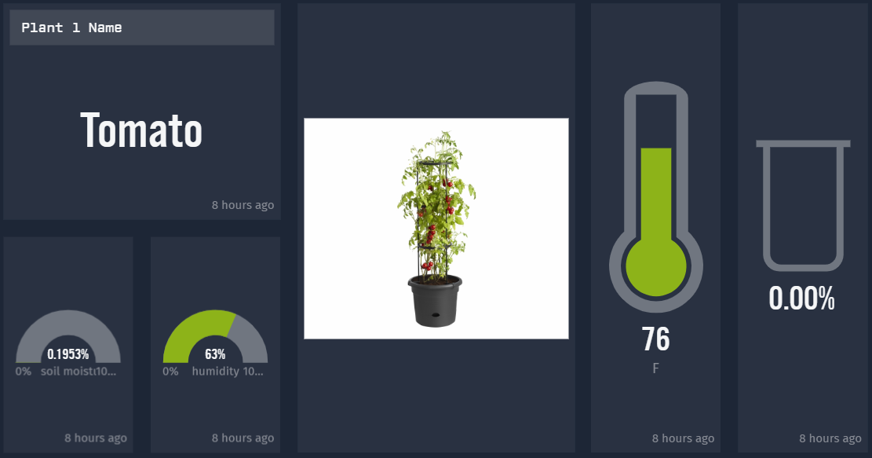
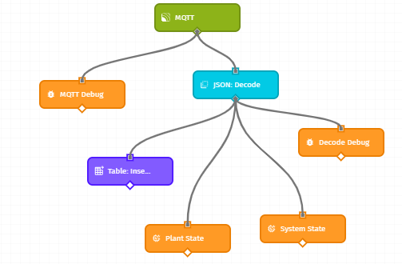
Programming
Embedded Software - Energia
Offers a wide selection of APIs
Object-Oriented C++
Built-in Multitasking
Web Application – HTML/Javascript
Losant Dashboards
Experience Views
Cloud communication – HTTP/MQTT
Losant workflows
PubNub clients

Slide 43
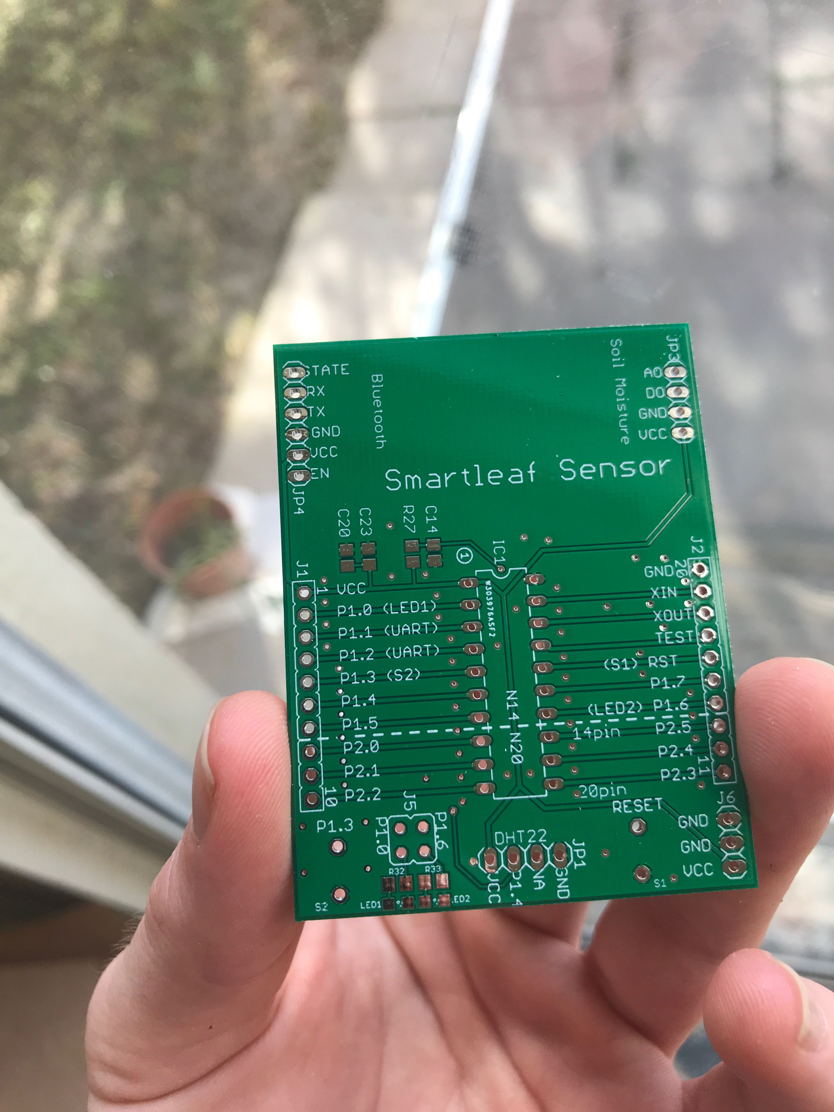
Prototype Development

Slide 44
Financing
Component | Price
Plexiglass panels | $40
Wood & miscellaneous hardware | $30
Water Tanks & Tubing | $15
Pumps | $16
LEDs | $14
Power Supply | $32
PCB | $60
ICs & on-board components | $34
Humidity & temperature sensor | $9
Soil moisture sensor | $26
Humidifier | $7
Fans | $8
Plants & soil | $30
Breakout boards & other test equipment | $90
Total | $471
Budget: $500

Slide 45
Changed Implementations
pH sensor: wasn’t adding the functionality that we thought
Touch screen LCD GUI: troubles adding the correct timings needed for our Kentec QVGA Display BoosterPack/correcting libraries
PCB difficulties
LED programming
Humidifier disk waterproofing

Slide 46
Questions?

